Slide 1
Introduction to Parallel Processing
Chapter 2

Slide 2
Parallel Computing
Parallel computing is a computing where the jobs are broken into discrete parts that can be executed concurrently.
Each part is further broken down to a series of instructions. Instructions from each part execute simultaneously on different CPUs.
Parallel systems deal with the simultaneous use of multiple computer resources that can include a single computer with multiple processors, a number of computers connected by a network to form a parallel processing cluster or a combination of both.
Parallel systems are more difficult to program than computers with a single processor because the architecture of parallel computers varies accordingly and the processes of multiple CPUs must be coordinated and synchronized.

Slide 3
The State of Computing
Modern computers are equipped with powerful hardware facilities driven by extensive software packages.
To assess state-of-the-art computing, we first review historical milestones in the development of computers.
Then we take a grand tour of the crucial hardware and software elements built into modern computer systems.

Slide 4
1. Computer Development Milestones
Prior to I945, computers were made with mechanical or electromechanical parts. The earliest mechanical computer can be traced back to 5110 BC in the form of the abacus used in China.
Blaise Pascal built a mechanical adder/ subtractor in France in 1642.
Charles Babbage designed a difference engine in England for polynomial evaluation in 1827.
Konrad Zusc built the first binary mechanical computer in Germany in 1941.
Howard Aiken proposed the very first electromechanical decimal computer, which was built as the Harvard Mark I by IBM in 1944. Both Zusc’s and Aiken’s machines were designed for general purpose computations.

Slide 5
Obviously, the fact that computing and communication were carried out with moving mechanical parts greatly limited the computing speed and reliability of mechanical computers.
Modern computers were marked by the introduction of electronic components.
The moving parts in mechanical computers were replaced by high-mobility electrons in electronic computers.
Information transmission by mechanical gears or levers was replaced by electric signals traveling almost at the speed of light.

Slide 6
Computer Generations
Over the past several decades, electronic computers have gone through roughly five generations of development.
The table below provides summary of the five generations of electronic computer development.
Each of the first three generations lasted about 10 years. The fourth generation covered a time span of 15 years. The fifth generation today has processors and memory devices with more than 1 billion transistors on a single silicon chip.
Generation | Technology and Architecture | Software and Applications | Representative Systems
First (1945-1954) | Vacuum tubes and relay memories, CPU driven by PC and accumulator, fixed-point arithmetic. | Machine assembly languages, single user, no subroutine linkage, programmed l/O using CPU. | ENIAC, Princeton IAS, IBM 701.
Second (1955-1964) | Discrete transistors and core memories, floating-point arithmetic, I/O processors, multiplexed memory access. | IILL used with compilers, subroutine libraries, batch processing monitor. | IBM T090, CDC I-I5-D4, Univac LARC.

Slide 7
Generation | Technology and Architecture | Software and Applications | Representative Systems
Third (1965-1974) | Integrated circuits (SS1/- MSI), microprograrnrning, pipelining, cache, and lookahead processors. | Multiprogramming and timesharing OS, multiuser applications. | IBM 360/370, CDC 6600, TI-ASC, PDP-8.
Fourth (1975-1990) | LSI/ VLSI and semiconductor memory, multiprocessors, vector supercomputers, multicomputer. | Multiprocessor OS, languages, compilers, and environments for parallel processing. | VAX 9000, Cray X-MP, IBM 3090, BBN TC2000.
Fifth (1991- present) | Advanced VLSl processors, memory, and switches, high-density packaging, scalable architectures. | Superscalar processors, systems on a chip, massively parallel processing, grand challenge applications, heterogeneous processing. | Desktop, Laptop, Notebooks, IBM’s Watson.

Slide 8
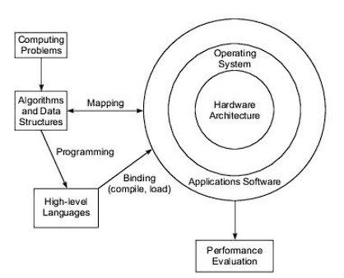
2. Elements of Modern Computers
Hardware, software, and programming elements of a modern computer system are briefly introduced below in the context of parallel processing.
The concept of computer architecture is no longer restricted to the structure of the bare machine hardware.
A modern computer is an integrated system consisting of machine hardware, an instruction set, system software, application programs, and user interfaces.

Slide 9
Computing Problems
The use of a computer is driven by real-life problems demanding cost effective solutions.
Depending on the nature of the problems, the solutions may require different computing resources.
For numerical problems in science and technology, the solutions demand complex mathematical formulations and intensive integer or floating-point computations.
For alphanumerical problems in business and government, the solutions demand efficient transaction processing, large database management, and information retrieval operations.
For artificial intelligence (Al) problems, the solutions demand logic inferences and symbolic manipulations.
These computing problems have been labeled numerical computing, transaction processing and logical reasoning.
Some complex problems may demand a combination of these processing modes.

Slide 10
Algorithms and Data Structures
Special algorithms and data structures are needed to specify the computations and communications involved in computing problems.
Most numerical algorithms are deterministic, using regularly structured data. Symbolic processing may use heuristics or nondeterministic searches over large knowledge bases.

Slide 11
Hardware Resources
Processors, memory, and peripheral devices form the hardware core of a computer system.
Special hardware interfaces are often built into l/O devices such as display terminals, workstations, optical page scanners, magnetic ink character recognizers, modems. network adaptors, voice data entry, printers, and plotters.
In addition, software interface programs are needed. These software interfaces include file transfer systems, editors, word processors, device drivers, interrupt handlers, network communication programs, etc. These programs greatly facilitate the portability of user programs on different machine architectures.

Slide 12
Operating System
An effective operating system manages the allocation and deallocation of resources during the execution of user programs.
Beyond the OS, application software must be developed to benefit the users.
Standard benchmark programs are needed for performance evaluation.

Slide 13
Mapping is a bidirectional process matching algorithmic structure with hardware architecture, and vice versa. Efficient mapping will benefit the programmer and produce better source codes. The mapping of algorithmic and data structures onto the machine architecture includes processor scheduling, memory maps, inter-processor communications, etc. These activities are usually architecture-dependent.
Optimal mappings are sought for various computer architectures. The implementation of these mappings relies on efficient compiler and operating system support.
Parallelism can be exploited at algorithm design time, at program time, at compile time, and at run time. Techniques for exploiting parallelism at these levels form the core of parallel processing technology.

Slide 14
System Software Support
Software support is needed for the development of efficient programs in high-level languages.
The source code written in a HLL must be first translated into object code by an optimizing compiler.
The compiler assigns variables to registers or to memory words, and generates machine operations corresponding to HLL operators, to produce machine code which can be recognized by the machine hardware.
A loader is used to initiate the program execution through the OS kernel.
Resource binding demands the use of the compiler, assembler, loader and OS kernel to commit physical machine resources to program execution. The effectiveness of this process determines the efficiency of hardware utilization and the programmability of the computer.

Slide 15
Compiler Support
There are three compiler upgrade approaches: preprocessor, precompiler, and parallelizing compiler.
A preprocessor uses a sequential compiler and a low-level library of the target computer to implement high-level parallel constructs.
The precompiler approach requires some program flow analysis, dependence checking, and limited optimizations toward parallelism detection.
The third approach demands a fully developed parallelizing or vectorizing compiler which can automatically detect parallelism in source code and transform sequential codes into parallel constructs.
The efficiency of the binding process depends on the effectiveness of the preprocessor, the precompiler, the parallelizing compiler, the loader, and the OS support.

Slide 16
Evolution of Computer Architecture
The study of computer architecture involves both hardware organization and programming/ software requirements.
As seen by an assembly language programmer, computer architecture is abstracted by its instruction set, which includes opcode (operation codes), addressing modes, registers, virtual memory, etc.
From the hardware implementation point of view, the abstract machine is organized with CPUs, caches, buses, microcode, pipelines, physical memory, etc.
Therefore, the study of architecture covers both instruction set architectures and machine implementation organizations.

Slide 17
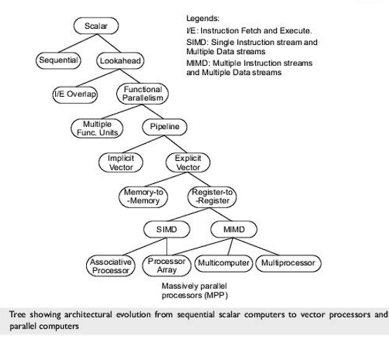
Over the past decades, computer architecture has gone through evolutional rather than revolutional changes.
As depicted in the figure, we started with the von Neumann architecture built as a sequential machine executing scalar data.
The sequential computer was improved from bit-serial to word—parallel operations, and from fixed—point to floating point operations.
The von Neumann architecture is slow due to sequential execution of instructions in programs.

Slide 18
Lookahead techniques were introduced to prefetch instructions in order to overlap I/E (Instruction Fetch/ Decode) operations and to enable functional parallelism.
Functional parallelism was supported by two approaches: One is to use multiple functional units simultaneously, and the other is to practice pipelining at various processing levels.
The latter includes pipelined instruction execution, pipelined arithmetic computations, and memory-access operations.
Pipelining is a technique where multiple instructions are overlapped during execution.
Pipelining has proven especially attractive in performing identical operations repeatedly over vector data strings.
Vector operations were originally carried out implicitly by software-controlled looping using scalar pipeline processors.

Slide 19
ARCHITECTURAL CLASSIFICATION

Slide 20
 Basic types of architectural classification
 FLYNN’S TAXONOMY OF COMPUTER ARCHITECTURE
 FENG’S CLASSIFICATION
 Handler Classification
 Other types of architectural classification
 Classification based on coupling between processing
elements
 Classification based on mode of accessing memory

Slide 21
ARCHITECTURAL CLASSIFICATION
 Flynn’s classification: (1966) is based on multiplicity of instruction streams and the data streams in computer systems.
 Feng’s classification: (1972) is based on serial versus parallel processing.
 Handler’s classification: (1977) is determined by the degree of parallelism and pipelining in various subsystem levels.

Slide 22
FLYNN’S TAXONOMY
ARCHITECTURE…
OF COMPUTER
 The most popular taxonomy of architecture was defined by Flynn in 1966.
computer
 Flynn’s classification scheme is based on the notion of a stream of information. Two types of information flow into a processor: instructions and data.
 The instruction stream is defined as the sequence of instructions performed by the processing unit.
 The data stream is defined as the
data traffic and the
exchanged between the memory
processing unit.

Slide 23
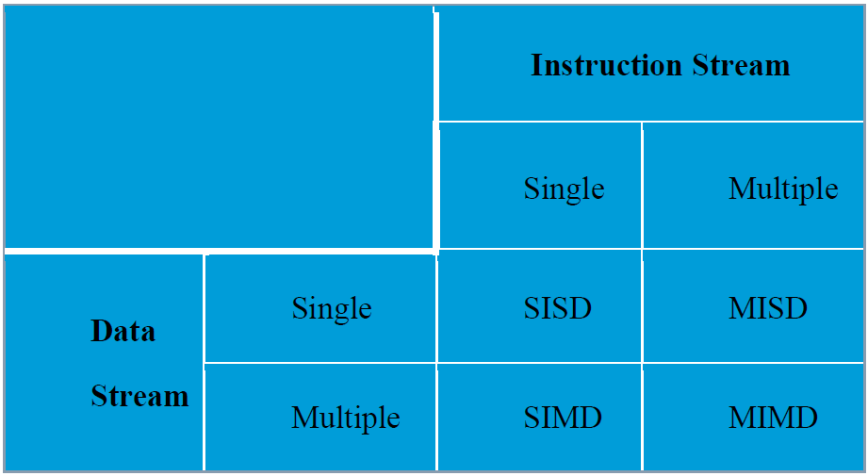
Types of FLYNN’S TAXONOMY
 to Flynn’s classification, either of the instruction or data streams can be single or multiple. Computer architecture can be classified into the following four distinct categories:
 single-instruction streams (SISD);
 single-instruction streams (SIMD);
single-data
multiple-data
 multiple-instruction single-data streams (MISD); and
 multiple-instruction multiple- data streams (MIMD).

Slide 24
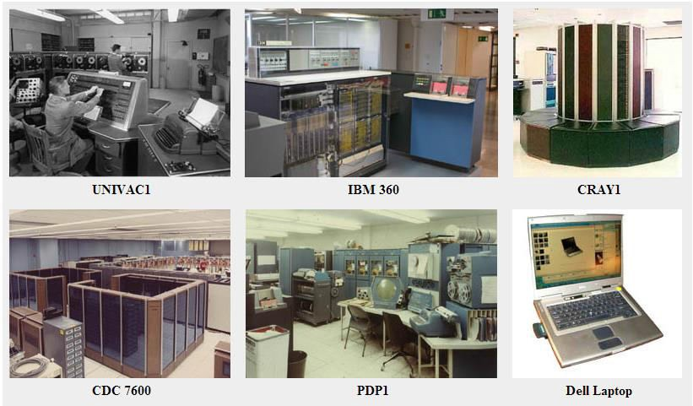
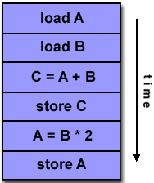
SISD
 Conventional single-processor von Neumann
computers are classified as SISD systems.

Slide 25
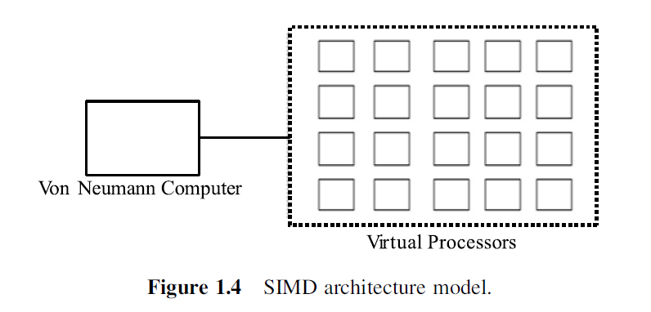
SIMD ARCHITECTURE
 The SIMD model of parallel computing consists of two parts: a front-end computer of the usual von Neumann style, and a processor array.
 The processor array is a set of identical synchronized
processing
capable of
elements
simultaneously
performing the same operation on different data.

Slide 26
SIMD ARCHITECTURE
 Each processor in the array has a small amount of local
memory distributed
where data
the resides
while it is being processed in parallel.
 The processor array is connected to the memory bus of the front end so that the front end can randomly access the local processor memories as if it were another memory.

Slide 27
SIMD ARCHITECTURE
 The front end can issue special commands that cause parts of the memory to be operated on simultaneously or cause data to move around in the memory.
 The application program is executed by the front end in the usual serial way, but issues commands to the processor array to carry out SIMD operations in parallel.

Slide 28
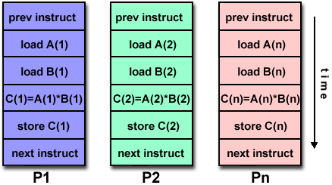
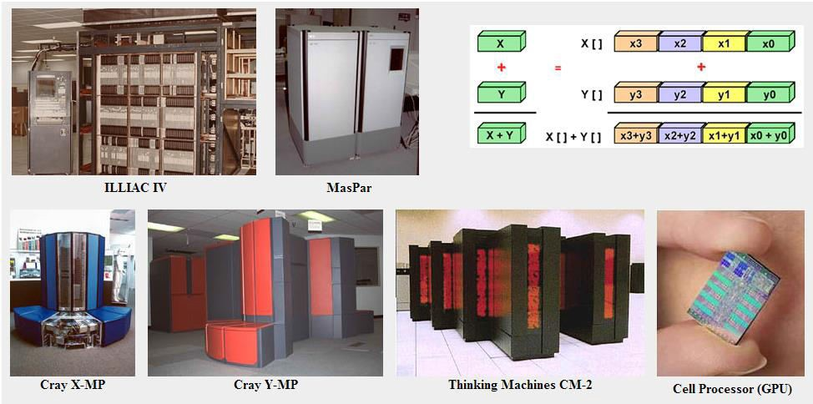

Slide 29
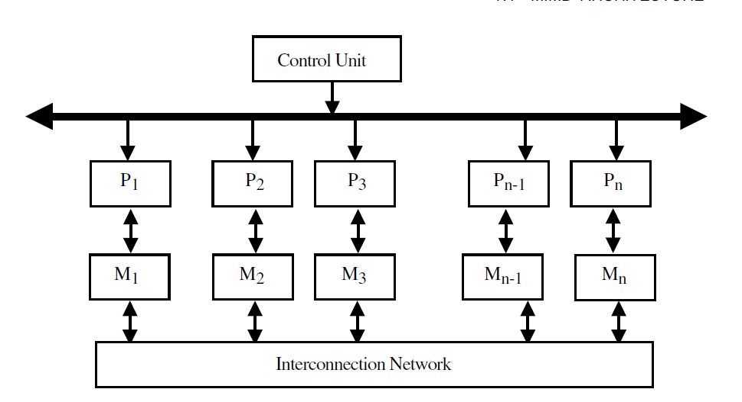
There are two main configurations that
have been used in SIMD machines.
In the first scheme, each processor has its own local memory. Processors can communicate with each other through the interconnection network.

Slide 30
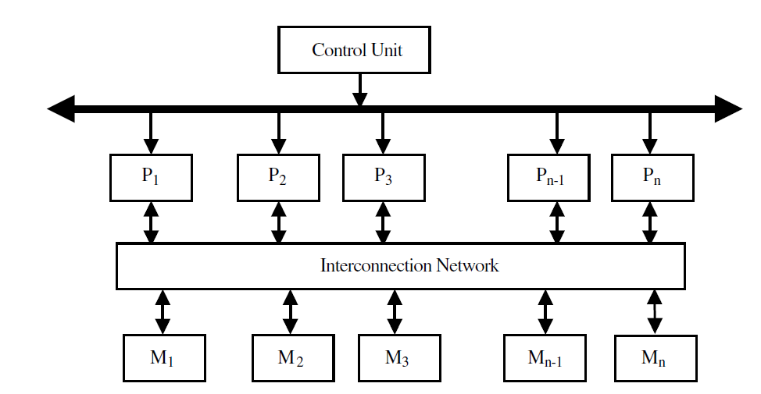
There are two main configurations that
have been used in SIMD machines.
second SIMD scheme, processors modules communicate with each interconnection network.
and other
memory via the

Slide 31
MIMD ARCHITECTURE
 Multiple-instruction multiple-data streams (MIMD) parallel architectures are made of multiple processors and multiple memory modules connected together via some interconnection network. They fall into two broad categories: shared memory or message passing.
 Processors exchange information through their central shared memory in shared memory systems, and exchange information through their interconnection network in message passing systems.

Slide 32
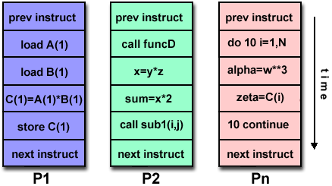
MIMD

Slide 33
MIMD “shared memory system“
 A shared memory system typically accomplishes inter-processor coordination through a global memory shared by all processors.
 Because access to shared memory is balanced, these systems are also called SMP (symmetric multiprocessor) systems.

Slide 34
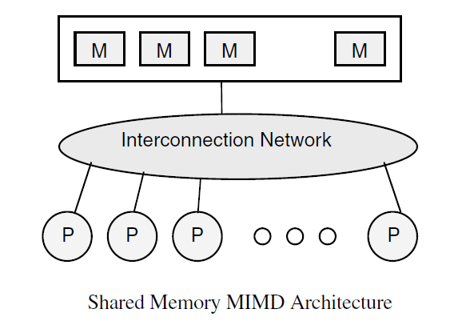

Slide 35
MIMD “message passing system”
 A message passing system (also referred to as distributed memory) typically combines the local memory and processor at each node of the interconnection network.
 There is no global memory, so it is necessary to move data from one local memory to another by means of message passing.
 This is typically done by a Send/Receive pair of commands, which must be written into the application software by a programmer.

Slide 36
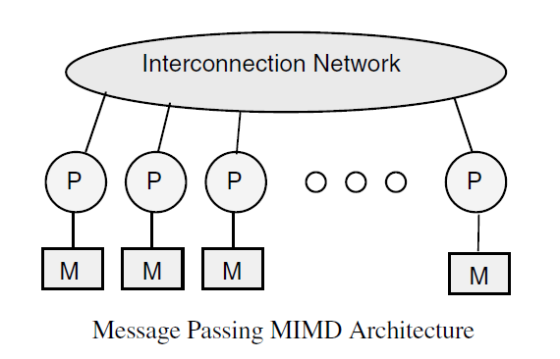

Slide 37
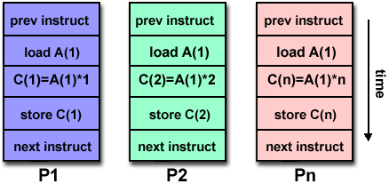
MISD ARCHITECTURE
 In the MISD category, the same stream of data flows through a linear array of processors executing different instruction streams.
 In practice, there is no viable MISD machine; however, some authors have considered pipelined machines (and
perhaps computers) for MISD.
systolic-array as examples

Slide 38
FENG’S CLASSIFICATION
 Tse-yun Feng suggested the use of degree of parallelism to classify various computer architectures.
 The maximum number of binary
digits that can be
processed within a unit time by a computer system is called the maximum parallelism degree P.
 A bit slice is a string of bits one from each of the words at the same vertical position.
 under above classification
 Word Serial and Bit Serial (WSBS)
 Word Parallel and Bit Serial (WPBS)
 Word Serial and Bit Parallel(WSBP)
 Word Parallel and Bit Parallel (WPBP)

Slide 39
 WSBS has been called bit parallel processing because one bit is processed at a time.
 WPBS has been called bit slice processing because m-bit slice is processes at a time.
 WSBP is found in most existing computers and has been called as Word Slice processing because one word of n bit processed at a time.
 WPBP is known as fully parallel processing in which
an array on n x m bits is processes at one time.

Slide 40
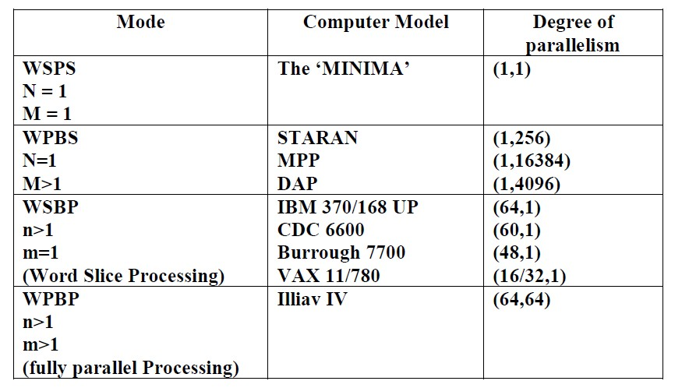

Slide 41
Handler Classification
 Wolfgang Handler has proposed a classification scheme for identifying the parallelism degree and pipelining degree built into the hardware structure of a computer system. He considers at three subsystem levels:
 Processor Control Unit (PCU)
 Arithmetic Logic Unit (ALU)
 Bit Level Circuit (BLC)
 Each PCU corresponds to one processor or one CPU. The ALU is equivalent to Processor Element (PE). The BLC corresponds to combinational logic circuitry needed to perform 1 bit operations in the ALU.

Slide 42
Classification based on coupling between processing elements
Coupling refers to the way in which PEs cooperate with one
another.
 Loosely coupled: the degree of coupling between the PEs is less.
Example: parallel computer consisting of workstations connected together by local area network such as Ethernet is loosely coupled. In this case each one of the workstations works independently.
If they want to cooperate they will exchange message. Thus logically they are autonomous and physically they do not share any memory and communication via I/O channels.
 Tightly coupled: a tightly coupled parallel computer, on the other hand shares a common main memory. Thus communication among PEs is very fast and cooperation may be even at the level of instructions carried out by each PE as they share a common memory.

Slide 43
Classification based on mode
of accessing memory
 Uniform memory access parallel computers (UMC): in a shared memory computer system all processors share a common global address space. For these systems the time to access a work in memory is constant for all processors. Such a parallel computer is said to have a Uniform Memory Access (UMA).
 Non uniform memory access parallel computers: in a distributed shared memory computer system, each processor may its own local memory and may or may not share a common memory. For these systems, the time taken to access a word in local memory smaller than the time taken to access a word stored in memory of other computer or common shared memory. thus this systems said to have Non Uniform Memory Access (NUMA)

Slide 44
Pipeline and its Principles
Pipelining is a technique of decomposing a sequential process into suboperations, with each subprocess being executed in a special dedicated segment that operates concurrently with all other segments.
The overlapping of computation is made possible by associating a register with each segment in the pipeline.
The registers provide isolation between each segment so that each can operate on distinct data simultaneously.
Perhaps the simplest way of viewing the pipeline structure is to imagine that each segment consists of an input register followed by a combinational circuit.
The register holds the data.
The combinational circuit performs the suboperation in the particular segment.
A clock is applied to all registers after enough time has elapsed to perform all segment activity.

Slide 45
The pipeline organization is demonstrated by means of a simple example.
To perform the combined multiply and add operations with a stream of numbers
A_{i} * B_{i} + C_{i} for i = 1, 2, 3, …, 7
Each suboperation is to be implemented in a segment within a pipeline.
R1 ← A_{i} , R2 ← B_{i} Input A_{i} and B_{i}
R3 ← R1 * R2, R4 ← C_{i} Multiply and input C_{i}
R5 ← R3 + R4 Add Ci to product

Slide 46
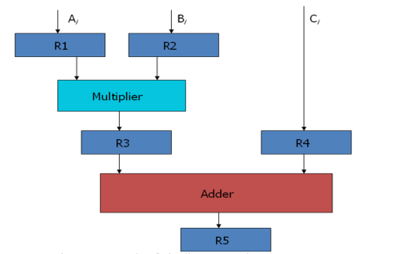
Each segment has one or two registers and a combinational circuit as shown in Fig below.

Slide 47
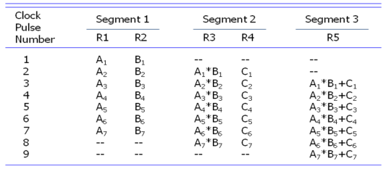
The five registers are loaded with new data every clock pulse. The effect of each clock is shown in the table.

Slide 48
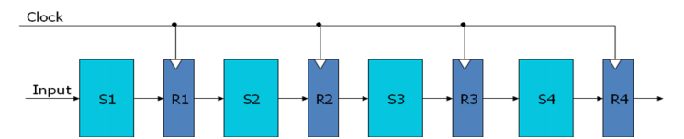
General Considerations
Any operation that can be decomposed into a sequence of suboperations of about the same complexity can be implemented by a pipeline processor.
The general structure of a four-segment pipeline is illustrated in Fig below.
We define a task as the total operation performed going through all the segments in the pipeline.

Slide 49
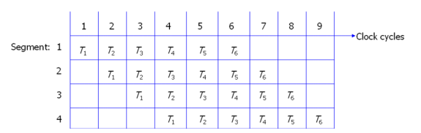
The behavior of a pipeline can be illustrated with a space-time diagram.
It shows the segment utilization as a function of time.
The space-time diagram of a four-segment pipeline is demonstrated in Fig below.

Slide 50
Let us consider a case where a k-segment pipeline with a clock cycle time t_{p} is used to execute n tasks.
The first task T1 requires a time equal to kt_{p} to complete its operation.
The remaining n-1 tasks will be completed after a time equal to (n-1)t_{p.}
Therefore, to complete n tasks using a k-segment pipeline requires k+(n-1) clock cycles.
Now, consider a non-pipeline unit that performs the same operation and takes a time equal to t_{n} to complete each task.
The total time required for n tasks is nt_{n}.
The speedup of a pipeline processing over an equivalent non-pipeline processing is defined by the ratio:
S = nt_{n}/(k+n-1)t_{p}

Slide 51
As the number of tasks increases, n becomes much larger than k-1, and k+n-1 approaches the value of n. Under this condition, the speedup becomes
S = t_{n}/t_{p}.
If we assume that the time it takes to process a task is the same in the pipeline and non-pipeline circuits, i.e., t_{n} = kt_{p}, the speedup reduces to
S = kt_{p} / t_{p}= k.
This shows that the theoretical maximum speed up that a pipeline can provide is k, where k is the number of segments in the pipeline.

Slide 52
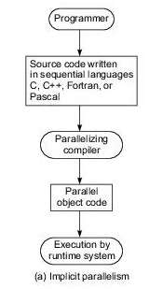
Implicit Parallelism
An intrinsic approach uses a conventional language, such as C, Fortran, Lisp or Pascal, to write the source program. The sequentially coded source program is translated into parallel object code by a parallelizing compiler. As illustrated in figure, the compiler must be able to detect parallelism and assign target machine resources. This compiler approach has been applied in programming shared-memory multiprocessors.
With parallelism being implicit, success relies heavily on the “intelligence” of a parallelizing compiler. This approach requires less effort on the part of the programmer.

Slide 53
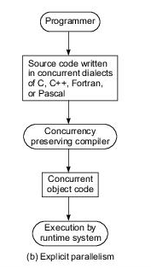
Extrinsic Parallelism
The second approach requires more effort by the programmer to develop a source program using parallel dialects of C, Fortran, Lisp, or Pascal. Parallelism is explicitly specified in the user programs. This will significantly reduce the burden on the compiler to detect parallelism. Instead, the compiler needs to preserve parallelism and, where possible, assigns target machine resources.

